Slide 1
Bellabeat Case Study: Understanding Consumer Behavior Through Smart Device Data

Slide 2
agenda
Ask Phase
Preparation Phase
Processing Phase
Analyzing Phase Phase
Sharing Phase

Slide 3
Ask Phase

Slide 4
Business Task & Goals
The objective of this case study is to analyze existing trends in the use of non-Bellabeat smart devices—such as fitness trackers and health-monitoring wearables—in order to gain insights into consumer behaviors and preferences.
These insights will then be applied to one of Bellabeat’s products to explore how the company can leverage these trends to better serve its customers.
The final goal is to use the identified trends to propose a data-driven marketing strategy or promotional campaign that aligns with the habits and needs of Bellabeat’s target audience.

Slide 5

Key stake holders
Bellabeat’s cofounder and Chief Creative Officer
Bellabeat executive team
Bellabeat marketing analytics team

Slide 6
Preparation Phase

Slide 7
Dataset Overview
This dataset contains health and fitness-related data collected from 30 individuals who used Fitbit smart devices over a period of several weeks , providing comprehensive insights into user behavior through multiple key metrics, including:
Daily and hourly physical activity
Calories burned
Heart rate
Sleep patterns
Weight and BMI logs
which enables behavioral analysis and pattern discovery based on real-world smart device usage.
The dataset is published under the CC0 public domain license, making it freely available for analysis and use.
Source: Fitbit Dataset on Kaggle

Slide 8
Data Storage &Organization
The original data was provided in two separate folders organized by collection date :
mturkfitbit_export_3.12.16-4.11.16
mturkfitbit_export_4.12.16-5.12.16
After preparation, the processed files were saved into three folders :
appended_data : contains merged files with the same structure across both original folders.
after_convert : contains files that were transformed from wide to narrow format.
final_preparing_data : contains cleaned and fully prepared files ready for analysis.
Most files are organized in long format, where each row represents a single observation However, some were initially in wide format, which was preserved temporarily to maintain original granularity, then transformed as needed during preparation
All datasets are stored in CSV format to ensure consistency, accessibility, and ease of use across tools.
The entire preparation process was documented and executed using a dedicated Jupyter Notebook (preparing.ipynb) for reproducibility and traceability. You can view the full notebook, including all folder paths and data processing steps, here.

Slide 9
Data Credibility &Limitations
Data Credibility
Data Limitations
Source The dataset was published on Kaggle and made available by Mobius under the CC0 Public Domain license
Data origin Collected from 30 real Fitbit users who consented to share their data
Device reliability Data was recorded using Fitbit smart devices which are widely recognized for accurate health tracking
ROCCC Check Reliable — Yes, trusted devices and real users Original — Yes, data comes directly from user devices Comprehensive — No, lacks demographic context Current — Not recent, collected in 2016 Cited — Yes, properly sourced and reference
Small sample size Only 30 users, which limits generalizability to the broader population
No demographics No info on age, gender, location, or medical background
Short time span The data was collected over a few weeks only, which may affect the ability to identify long-term trends or seasonal patterns
Potential bias Participants might be more health-conscious or active than the average user and it small sample just 30 user
Missing values Some files contain incomplete or missing records including null values in weight and body fat logs
Activity Gaps
Time gaps may exist due to inconsistent device usage or syncing, affecting the continuity of the recorded data.

Slide 10
processing Phase

Slide 11
Data Processing Overview
This section describes how I cleaned, validated, and transformed the Bellabeat datasets to prepare them for analysis. All decisions were based on initial data profiling results and were documented step by step.
Tools Used
File Organization
Tool: Python (Pandas) in Jupyter Notebook Why: Offers full control, automation, and scalability for cleaning and transformations
Folder structure:
final_prepared_data
data_after_standardization_and_type_change
data_after_removing_nulls_and_duplicates
data_after_removing_outliers
validation_scripts
Each folder represents a processing stage and is validated with a dedicated notebook.

Slide 12
Data Integrity Validation
Before applying any transformations, I created a folder named validation_scripts containing individual notebooks to validate each processing stage.
A custom function called analyze_all_csv() was used to perform consistent data profiling across all datasets. It checks for:
Missing values
Duplicate rows
Data types
Outliers using the IQR method
Each cleaning step was validated both before and after execution. This helped identify:
Inconsistent date formats
Columns with high percentages of null values
Hidden duplicates that appeared after standardizing data types
This framework ensured data quality and created a clear audit trail for the entire cleaning process.

Slide 13
Data Processing Flow
Step 1: Preparing Phase
- Combined monthly exports using `append`
- Converted some files from wide to long format
- Removed early duplicates and nulls after concatenation
- Note: These steps were actually completed during the **Preparing Phase**, but are documented here to provide full context for the overall processing workflow
Saved to: `final_prepared_data/`
Step 2: Date and Type Standardization
- Validated input: `final_prepared_data/`
- Standardized all datetime formats across datasets (e.g., `"YYYY-MM-DD HH:MM:SS"`)
Updated data types for consistency (e.g., converting string dates to datetime)
Saved to: `data_after_standardization_and_type_change/`
Re-validated the standardized datasets using a dedicated notebook

Slide 14
Data Processing Flow
Step 3: Removing Nulls and Duplicates
- Validated input: `data_after_standardization_and_type_change/`
- Dropped remaining missing values (e.g., `Fat` column)
- Detected and removed duplicates that appeared after datetime unification
- Saved to: `data_after_removing_nulls_and_duplicates/`
Re-validated the cleaned outputs.
Step 4: Outlier Removal
- Validated input: `data_after_removing_nulls_and_duplicates/`
- Applied the IQR method to numeric columns
- Removed extreme and negative values
- Saved to: `data_after_removing_outliers/`
-Considered the final version for analysis

Slide 15
Final Deliverable
Clean, validated, and analysis-ready datasets
Each cleaning step is fully documented in Jupyter Notebooks
Notebooks include code, output logs, and markdown explanations
All stages are saved in clearly labeled folders (e.g., data_after_standardization_and_type_change)
The entire workflow is reproducible and fully auditable
You can review the cleaning logic and results inside: processing_file.ipynb
validation_scripts/ (contains 4 validation notebooks, one for each processing phase)
Full processing notebook available at: [put your link here]

Slide 16
Analyzing Phase

Slide 17
Analyze Phase Overview
In this phase, I explored and analyzed the processed data to uncover trends, patterns, and user behaviors using non-Bellabeat smart devices.
The main goal was to support Bellabeat’s business objectives by identifying behavioral trends that can inform both marketing and product decisions.
The analysis focused on data related to activity, sleep, calories burned, and weight, all collected from wearable fitness trackers.
All analysis was conducted using Python, with the help of Pandas for data manipulation, and Matplotlib and Seaborn for data visualization. The entire process was documented in a Jupyter Notebook.

Slide 18
Methods and Tools Used
Data Aggregation: Grouped data by day, hour, and activity type to calculate totals and averages
Data Formatting: Converted date columns to datetime format and extracted weekday names and hours
Data Merging: Combined related datasets such as calories, steps, and intensity
Calculations: Created new variables such as TotalActiveMinutes, and performed summation and averaging
Visualization Tools:
Matplotlib for pie charts and bar charts
Seaborn for heatmaps and stylized visualizations
Multiple subplots were used to efficiently compare variables side-by-side

Slide 19
Key Questions Explored
What types of physical activity do users engage in most?
Do users prefer automatic or manual logging of data?
What is the relationship between physical activity and calories burned?
What are the most and least active days of the week?
How does sleep duration relate to calories burned and activity level?
What hours of the day show the highest intensity, steps taken, and calories burned?
What is the average weight and BMI of users?
All of these questions were explored through the data without extracting final insights at this stage.

Slide 20
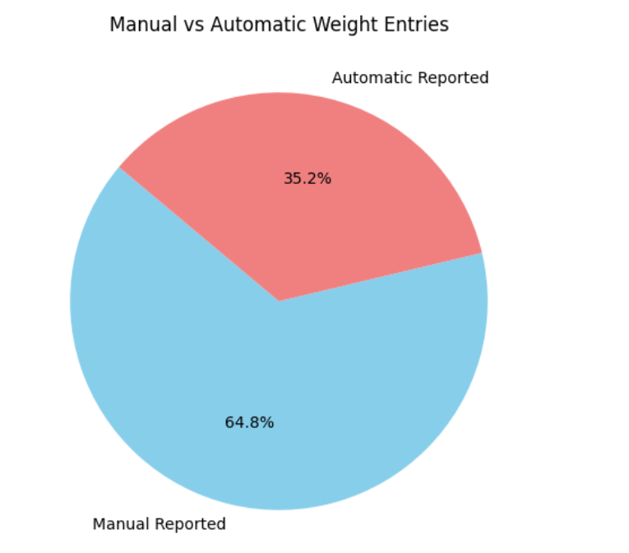
Visual Summary of Trends
This chart highlights whether users rely more on automatic weight tracking or manual entry, helping Bellabeat understand user preferences and reduce friction in data logging.
Manual vs Automatic Weight Entries
This chart is just one example of the behavioral patterns discovered during analysis. For the full analysis, more visualizations, and detailed insights, please refer to the Jupyter Notebook

Slide 21
Summary of Key Observations from the Data
Users spend most of their active time in light activities, rather than moderate or very active ones.
There is a strong reliance on automatic tracking over manual input, both for activity and weight logging.
Automatically tracked distances are significantly higher than manually logged distances.
Peak activity occurs between 5 PM and 7 PM, with the highest steps, calories burned, and intensity.
The most active days of the week are Tuesday and Wednesday, while Sunday is the least active.
Sleep data is partially incomplete but suggests a moderate relationship between sleep duration, calories burned, and distance.
The average BMI across users falls into the overweight or obese category.
Note: These findings reflect general behavioral trends and patterns observed during the analysis phase. They will be used to generate actionable insights in the Share phase, aligned with Bellabeat’s business goals.

Slide 22
Sharing Phase

Slide 23
Communicating Findings
In this phase, I focused on presenting the key insights derived from the analysis through clear and actionable visualizations.
This phase translates raw analysis into real business value, helping Bellabeat align its product and marketing strategies with actual user behavior
A separate stakeholder-facing presentation was created to highlight:
Trends in user behavior
Opportunities for product design
Data-driven marketing recommendations
The visualizations were designed to be:
Easy to understand
Visually engaging
Directly linked to business objectives
A full summary of insights and recommendations is available in the stakeholder presentation

Slide 24
thank you
Mohamed yehea
mohamed11710w@gmail.com

